Slide 1
Improving Productivity Using FME Workbench
Robert Schultz Heidi Lee
Geomatics Coordinator Geomatics Technologist
RCMP E Division RCMP E Division
April 27, 2012
Notes:
Robert
Introduce myself and Heidi
Today we are going to highlight some of the ways that FME has improved our productivity.
Heidi and I are going to be switching back and forth.

Slide 2
Improving Productivity Using FME Workbench
Overview RCMP Geomatics
PRIME Map Data Updates
GPS Log Mapping
Wrap Up and Questions
Notes:
Robert
-I will start with a brief overview of our unit and our role in the RCMP
Then we will discuss how we have applied FME technology to the updating of map data for PRIME and mapping of GPS log data.
At the end we will be happy to answer any questions you might have.

Slide 3
RCMP Geomatics and Mapping
Provide Geo-Spatial Data and Analytical Services
  Analytical and Administrative Mapping
  Server Application Development
  Advice and Guidance – SME
  Maintenance of Province Wide Base Map
  Resolving Address Validation Issues
  Production of Custom Map Data
  Mapping GPS Logs
Notes:
Robert
We provide a wide range of geomatics support and services to the RCMP in BC in addition to the Municipal forces and our clients. The services include:
Mapping of administrative boundaries, analysis
Manage and maintain a GIS server and deployment of application.
The unit is the Subject Matter Expert in GIS and Mapping for the Division. We provide advice and guidance on the use of geo-spatial technologies to meet the goals of RCMP units in BC.
Maintain and distribute a Province-wide base map that includes a Fully Addressed Centerline Road Network, Parks, Lakes, Police Jurisdiction Boundaries and First Nation Reserves.
Troubleshoot and resolve issues with addresses that do not validate in the dispatch and records systems.
Produce customized map data for specific application. Specifically for the map applications that are part of the dispatch software and the police car mobile work stations.
Process and map GPS logs from tracking devices and police cars.

Slide 4
Improving Productivity Using FME Workbench
PRIME Map Data Updates
GPS Log Mapping
Notes:
Robert
- Today we would like to highlight how FME Workbench has streamlined our workflows and significantly improved our productivity.
- We are going to focus on two specific processes: PRIME Map Data Updates and GPS Log Mapping.
- These are core tasks to the RCMP in BC and require timely completion.

Slide 5
PRIME Map Data Updates
PRIME
  Police Records Information Management Environment
Dispatch and Record Management
Notes:
Robert
The PRIME system provides dispatch and record management for all police forces across the province.
All police forces use this system which facilitates the sharing of information between the various police forces.
We provide mapping support for all RCMP jurisdictions across the Province

Slide 6
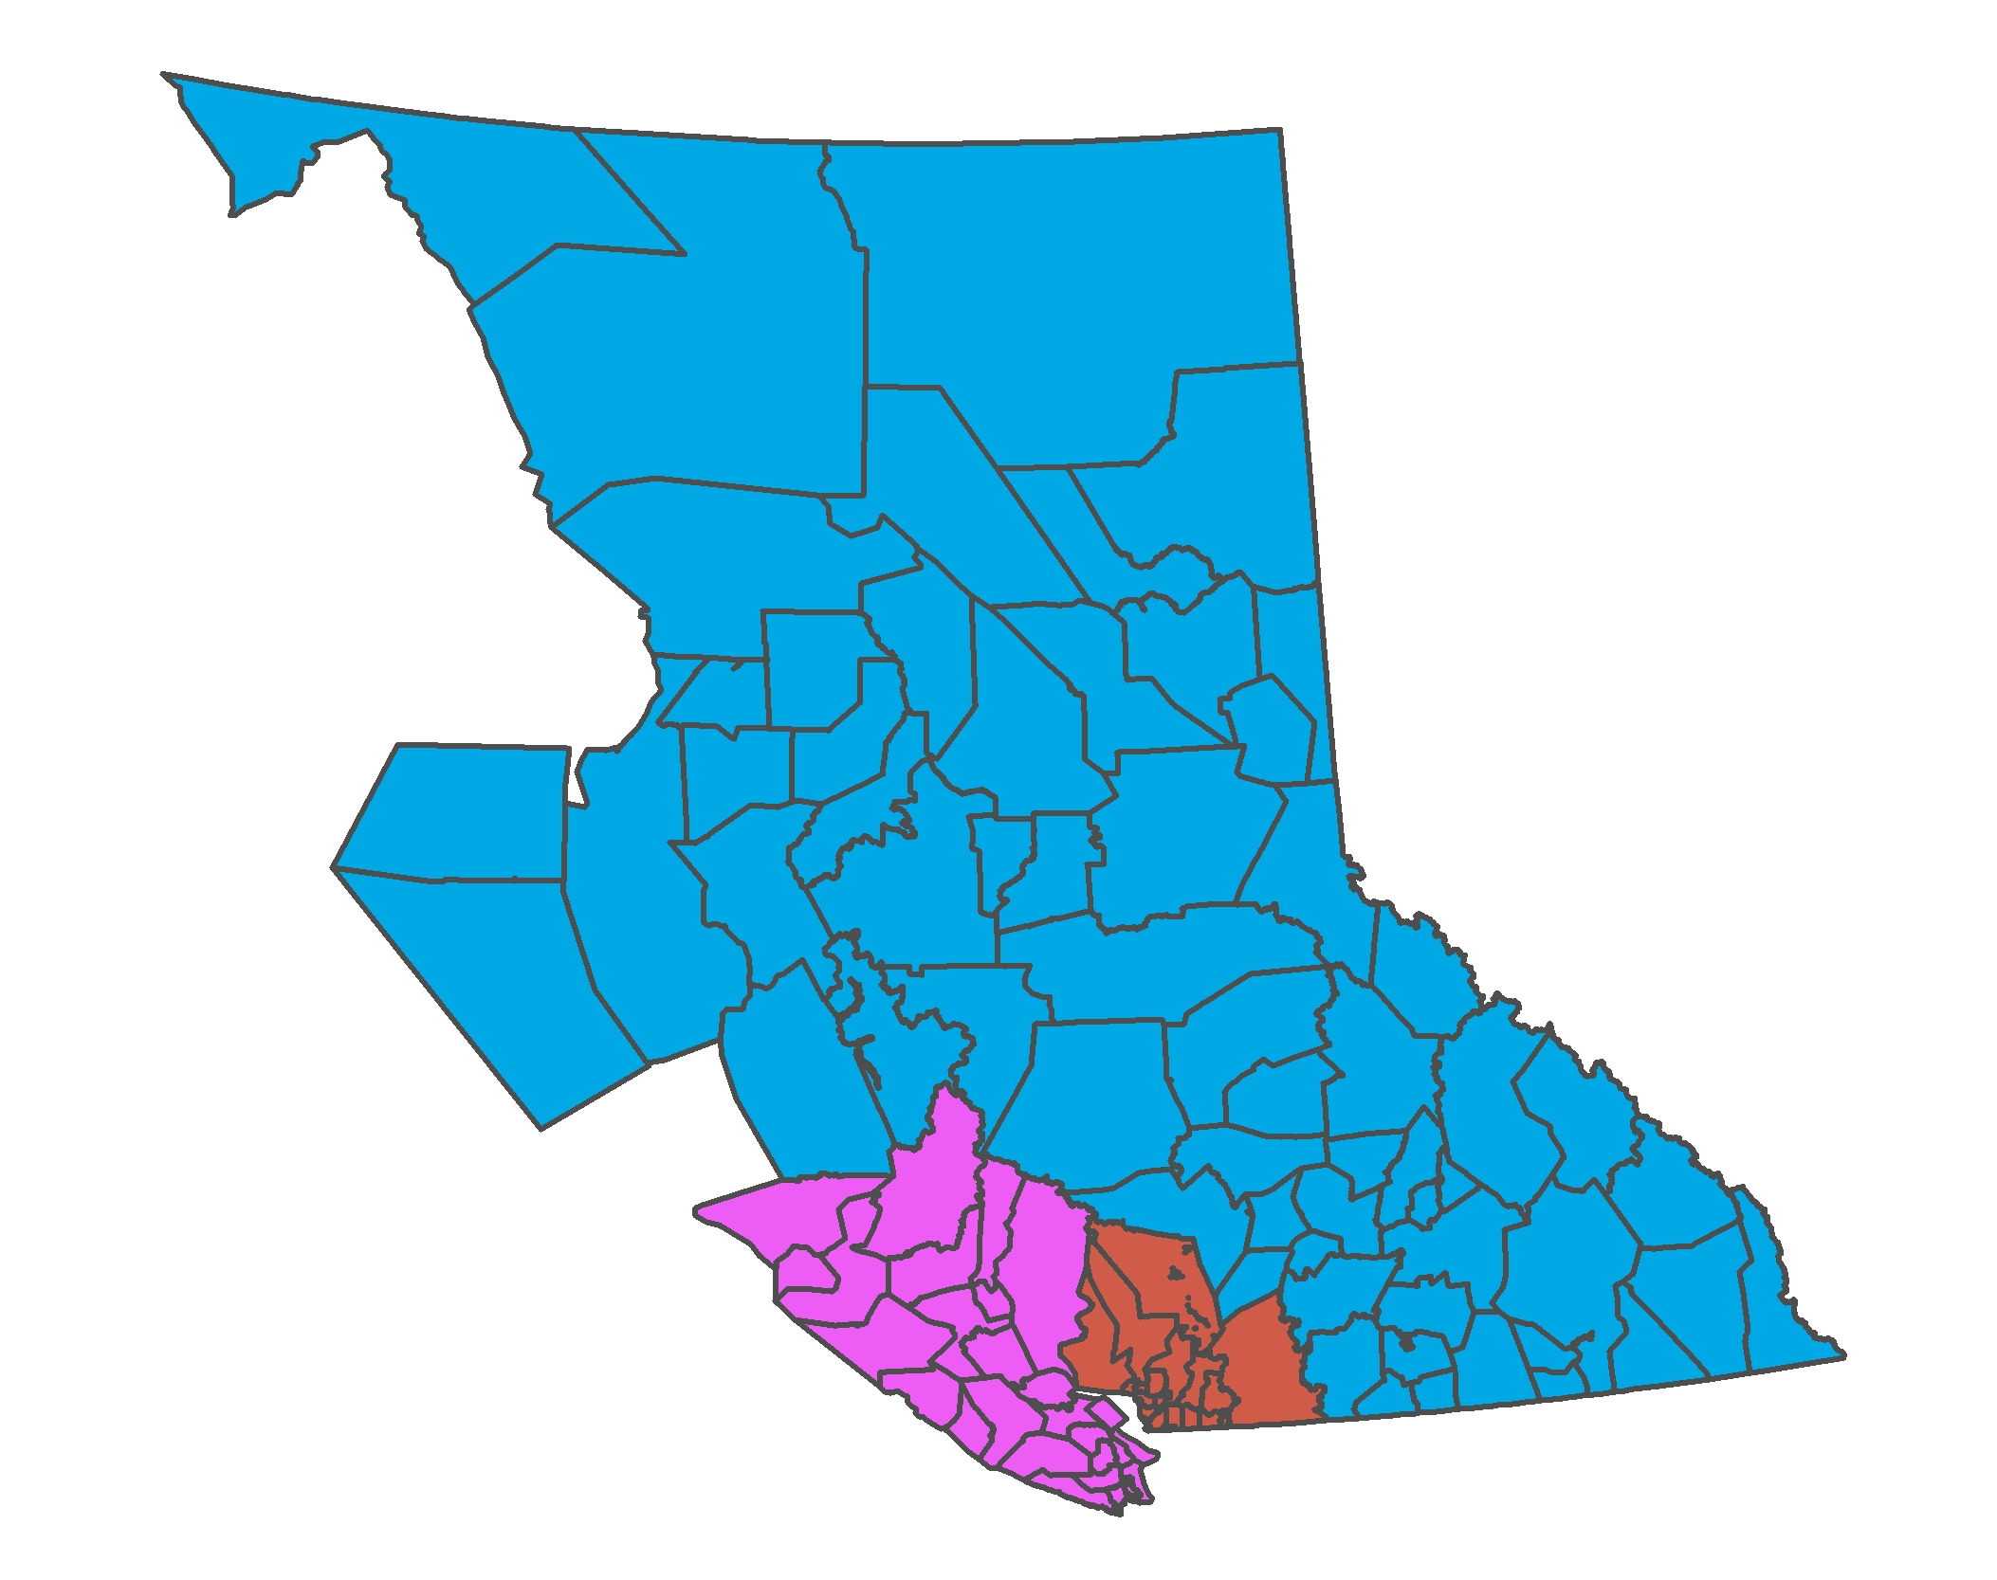
PRIME Map Data Updates
Notes:
Robert
Divided into three separate servers each has it’s geographic data updated quarterly resulting in a street file update every month.
When the data is updated, a series of shapefiles is produced for use in the dispatch and police car map application
In addition, attribute spreadsheets of the street file are generated for each police jurisdiction covered by the server

Slide 7
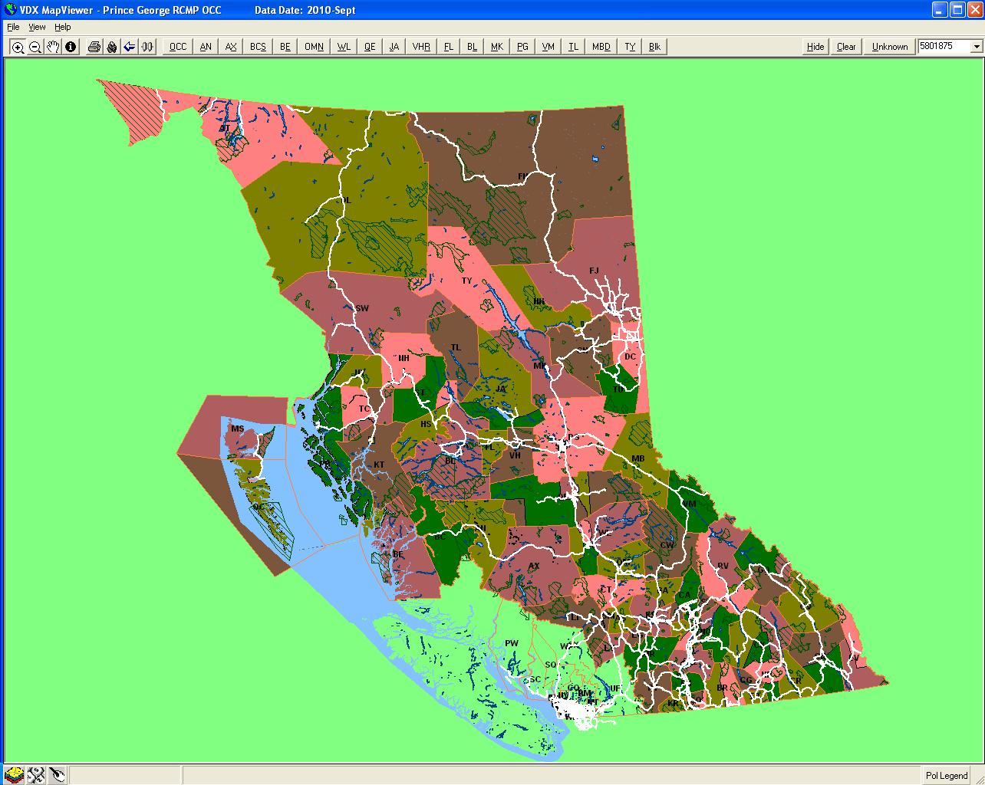
PRIME Map Data Updates
Notes:
Heidi
This is the dispatch mapviewer. A similar version is used in the police cars.
It is simple application that displays shapefile base map data, locations of calls and location of police cars.
The different coloured zones are the various patrol zones within each police jurisdiction
Initially, a single shapefile is provided for all the zones across the server area during an update
Zones across the region are grouped to ensure that colours between them are different
A separate shapefile needs to be generated for each of the zone groups so that the symbology in mapviewer can be set

Slide 8
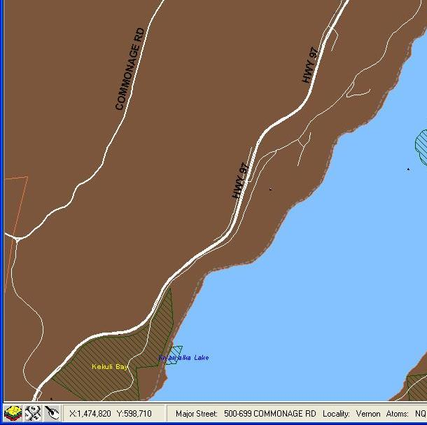
PRIME Map Data Updates
Notes:
Heidi
As well additional attribution needs to be added to the road shapefiles to display the address range and street names along the bottom of the mapviewer.

Slide 9
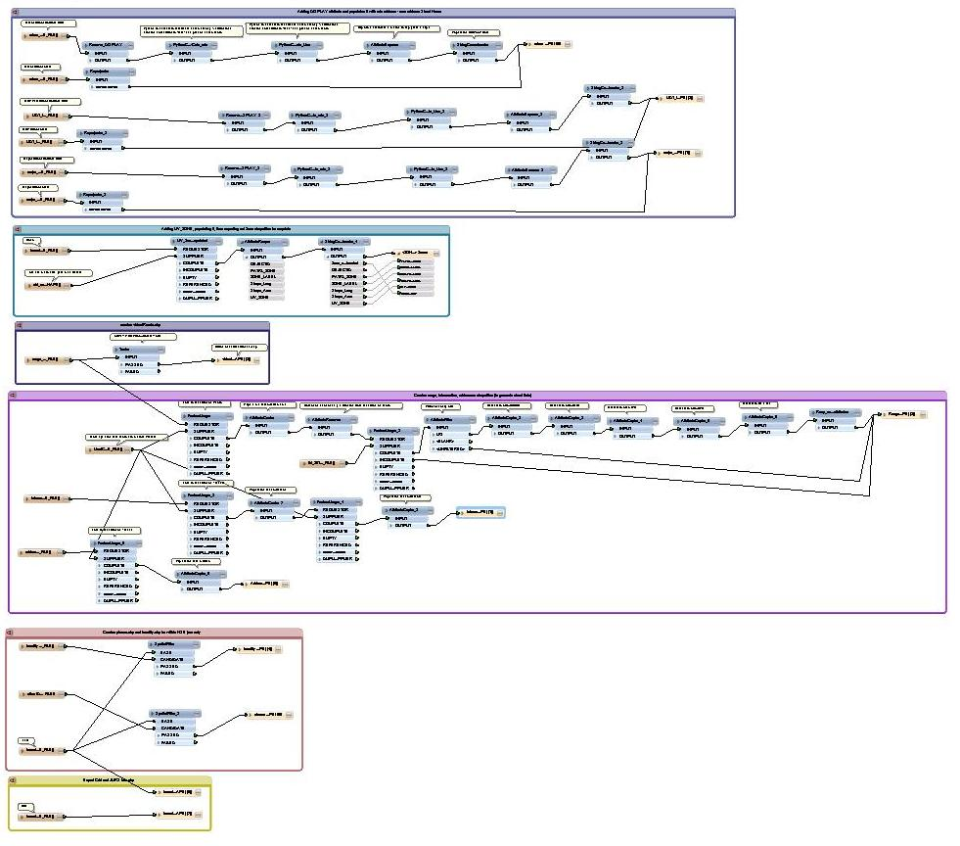
PRIME Map Data Updates
Notes:
-Previously the process of producing the PRIME map data involved 10 separate scripts run in ArcGIS that automated portions of the process.
-had to be separate models due to mutliple different inputs and outputs
-above is a screen shot of the entire fme model for an NSE update.
-The red circles display all of the inputs while the green circles display all of the outputs
-as you can see, all of the data is handled differently
-There was still significant manual interaction to produce the final products
-Typically the process took from 1 to 1.5 days.

Slide 10
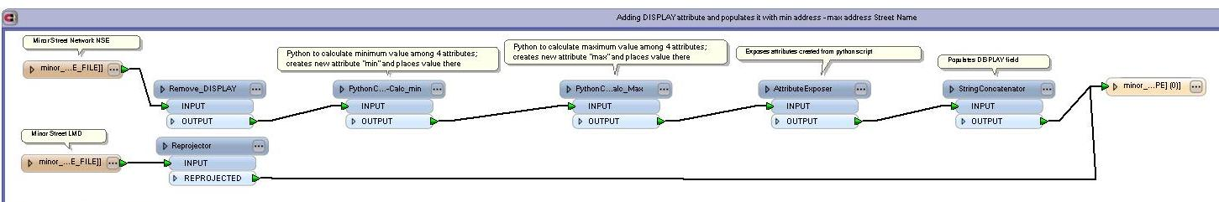
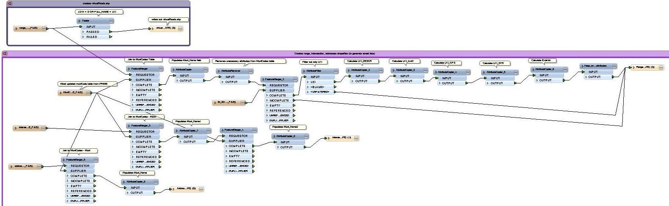
PRIME Map Data Updates
Notes:
-The tools in FME Workbench have allowed us to make the data processing portion of a Map Data update completely automated.
-This has reduced the time to about 2 hours.
-The only manual interaction is copying the data between the processing server and network shared drives
Here is a snapshot of some parts of the model.
Click
This part joins the street data from two data sets, adds the fields, calculates the min and max value, and concatenates it all into one DISPLAY field: 100-2000 Main St.
This is done with all of the major, minor, MDT, street files.
Click
This part joins the muni codes table to the address, intersection, range files and populates the appropraite fields in each dataset and then exports them out as a shapefile.

Slide 11
GPS Log Mapping
Police Cars Equipped with GPS Receivers
  Facilitates Dispatch
  Better Geographic Distribution
Location History is Logged
Notes:
Robert
Most police cars are equipped with GPS receivers that are used to track the location of the car.
This facilitates the dispatch of the closest car to a call for service and allows watch commanders to ensure that police resources are appropriately allocated geographically.
Upon occasion the location history of a police car needs to be mapped. Consequently the GPS locations of cars are logged.
Heidi will outline how FME has improved our productivity and deal with two specific issues with GPS logs – Log Size and Variable Field Formats

Slide 12
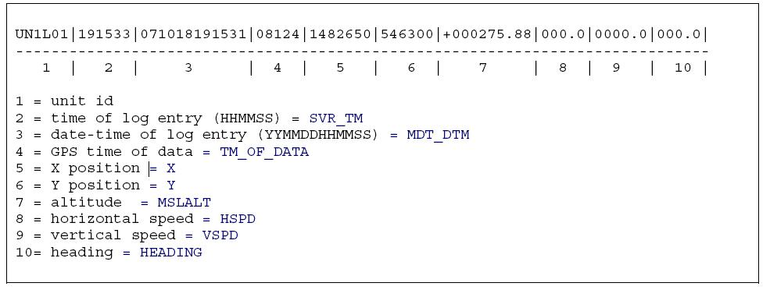
GPS Log Mapping
Notes:
Heidi
This is the structure of a GPS log record.
To import the GPS log into ArcGIS and to use the date and time, a Date-Time field needs to be calculated from the raw log
Click. The date is extracted from the MDT Date-Time field and the time is calculated from the GPS time field. Click.
The two values are then appended together to produce the ArcGIS Date-Time field
This process was originally done using a spreadsheet template and formulas.
We imported the raw log into a spreadsheet, calculated the date-time field with a formula and used the GIS software to create the shapefile or file geodatabase.
As the demand for mapping of GPS logs increased, we encountered several issues that the use of FME helped us deal with

Slide 13
GPS Log Mapping
Size of GPS Logs
  Typical log has 5 – 15 thousand records
  Log for one server for an entire day can exceed 400,000 records
Notes:
Heidi
The manual spreadsheet process becomes impractical once we started dealing with larger GPS logs
Most logs typically have thousands of records
Server logs for an entire day can have over 400,000.
This was a time consuming process that could take hours in the case of one or two logs or days if there were more.
With more and more full day logs being provided, it became impractical to process the raw log using a spreadsheet.

Slide 14
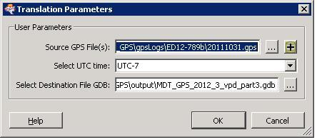
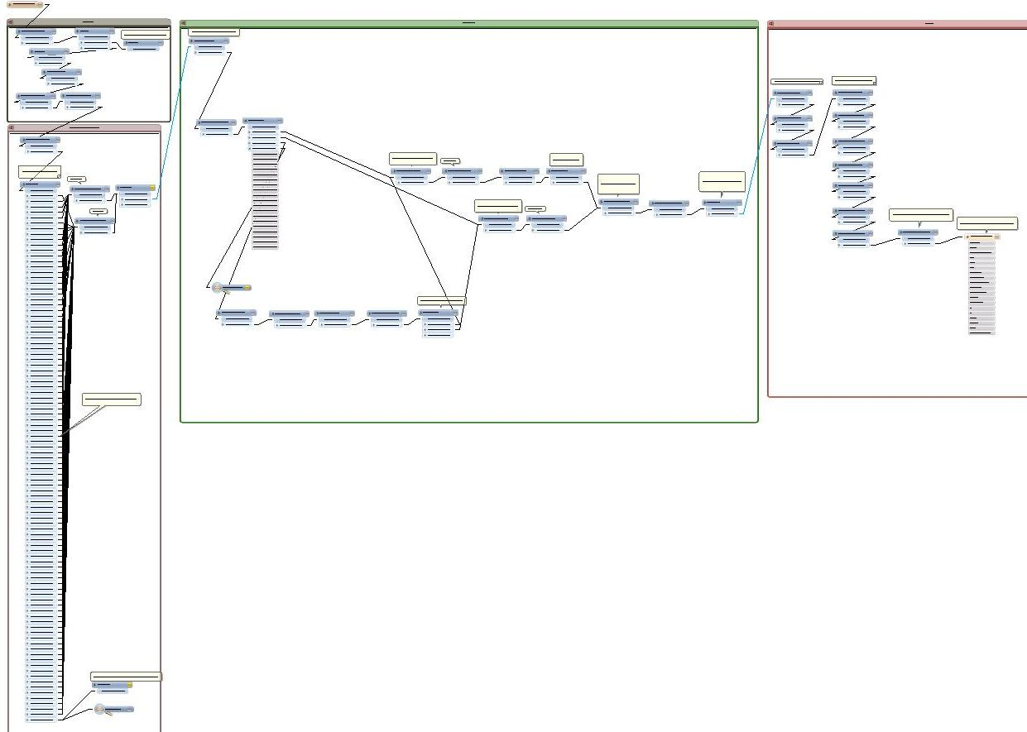
GPS Log Mapping
Notes:
Prior to implementing FME workbench, the process of manually importing a GPS log into a spreadsheet, copying the formulas to calculate the date-time field, importing into ArcGIS and producing the map took about a half a day.
Multiple logs would take many days and was compounded by limitation of the number of records the spreadsheet software could handle.
Automating the data processing steps has allowed us to reduce the turnaround time of a single GPS map to an half hour or so.
This has been particularly valuable in allowing us to complete large requests in a reasonable time. For example, several months of server wide GPS logs can be processed in about 11 hours of server time while we work on other tasks and the maps can then be produced in a day or so.
Overview of entire model.
Animation
When you start the model you set your parameters
Select one or more gps logs
Logs records without a xy or time value
Filters and sets the projection based on the unit id; nse/vir = bc albers; lmd = utm 10
Visuzlier and Log connected to Unit ID test filter and will visualize/log any records without a unit id
Calculates the date and time; first test filter for time character length
Second test filter for time character length
Addition of extra fields for easier map making
Final output as a file gdb. All logs will be placed in the one file geodatabase.

Slide 15
GPS Log Mapping
Variable Field Formats
  As hardware was upgraded, the GPS Time field format began to change
  Field values went from 5 to 6 characters
    5 Characters = Seconds from UTC
    6 Character = HHMMSS
Notes:
Heidi
As GPS hardware was upgraded in the police cars, it was discovered that the field for the GPS time began to change from 5 characters to 6 characters is some of the log entries.

Slide 16
GPS Log Mapping
  The addition of decimals complicated things
    Seconds
      12345 → 5 characters
      12345. → 6 characters
    HHMMSS
      123456 → 6 characters
      123456. → 7 characters
      123456.000 → 10 characters
  Resulted in using TWO TestFilter transformers
Notes:
Issues with TIME field
Have to deal with front and back zero’s therefore have to store as text
Some time data comes to us in seconds, HHMMSS, with decimals or without
Script in TCLCaller that calculates PST based on UST (daylight savings or not) only works when it is an integer

Slide 17
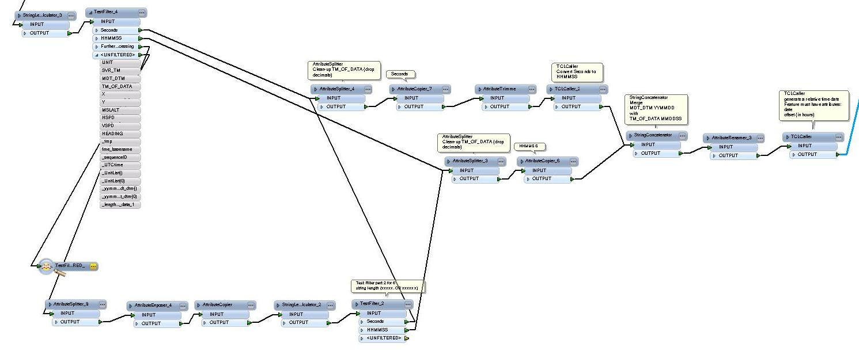
GPS Log Mapping
Notes:
Heidi
We used two TestFilter transformers to determine the size of the field and correctly calculate the time of the GPS coordinate
when the string length is 6, the attribute gets split by the decimal (if there is one) and then runs through the test filter again (5 → Seconds; 6 → HHMMSS)
splitting the value by the decimal is only done in the second processing because TM_OF_DATA sometimes has a decimal and sometimes doesn’t
Calculation of the time includes the conversion from seconds to HHMMSS (if necessary), from DST to PST, as well as day light savings (an option you select when you run the model)
-The date from the MDT_DTM is then concatenated with the calculated time into a YYYYMMDDHHMMSS field
FME most useful with the calculating of the time
Model looks complicated
Reduces human error

Slide 18
Improving Productivity Using FME Workbench
Simplified Data Processing
Handles Variable Field Formats
Handles Large Files
Allows Timely Turnaround
Notes:
Robert
-FME has:
-Simplified the processing of data from many steps that requires user interaction at each point to a single script.
-Easily generate usable spatial data from unstructured tables with varying filed formats.
-Handle large file sizes that make manual processing impractical.
-Allows us to quickly process custom map data for dispatch and gps logs.

Slide 19
Thank You!
Questions?
For more information:
  robert.o.schultz@rcmp-grc.gc.ca
  heidi.lee@rcmp-grc.gc.ca

